Slide 1

Structured Query Language

Slide 2
Table of Contents
Introduction to SQL
Subsets of SQL
DDL
DML
DCL
TCL
SQL Operators
SQL Functions
SQL SET Operators
SQL Joins

Slide 3
Introduction to SQL

Slide 4
What is SQL ?
Programming language specifically designed for working with Database to…
CREATE
MANIPULATE
SHARE/ACCESS

Slide 5
Why SQL?
SQL is widely popular because it offers the following advantages:
Allows users to access data in the relational database management systems.
Allows users to describe the data.
Allows users to define the data in a database and manipulate that data.

Slide 6
SQL Terms
Data
Data is defined as facts or figures, or information that's stored in or used by a computer.
Database
A database is a collection of information that is organized so that it can be easily accessed, managed and updated.

Slide 7
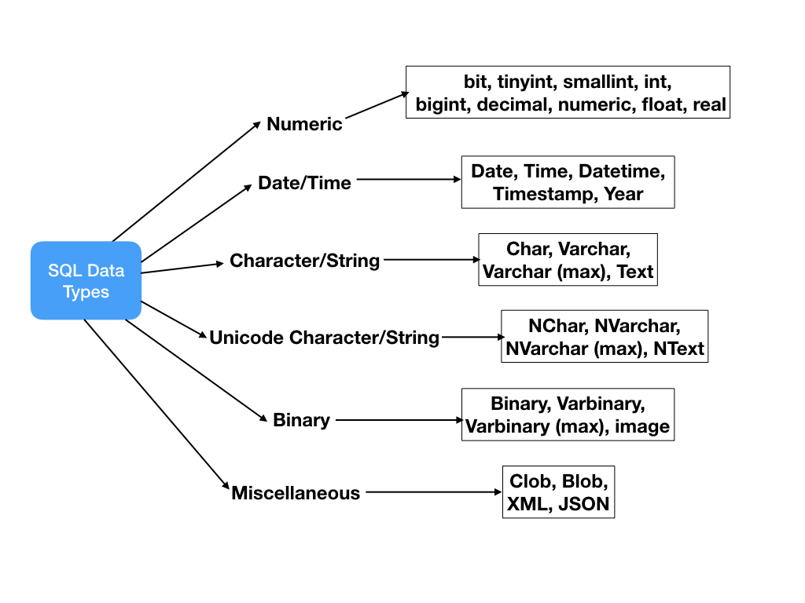
SQL Data Types

Slide 8
SQL Constraints
Constraints are the rules enforced on data columns on a table.
These are used to limit the type of data that can go into a table.
Constraints can either be column level or table level.
Constraint | Description
NOT NULL | Ensures that a column cannot have a NULL value.
DEFAULT | Provides a default value for a column when none is specified.
UNIQUE | Ensures that all the values in a column are different
PRIMARY | Uniquely identifies each row/record in a database table
FOREIGN | Uniquely identifies a row/record in any another database table
CHECK | The CHECK constraint ensures that all values in a column satisfy certain conditions.
INDEX | Used to create and retrieve data from the database very quickly.

Slide 9
Subsets of SQL

Slide 10
SQL Command Groups
DDL (Data Definition Language) : creation of objects
DML (Data Manipulation Language) : manipulation of data
DCL (Data Control Language) : assignment and removal of permissions
TCL (Transaction Control Language) : saving and restoring changes to a database

Slide 11
DDL - Data Definition Language
Command | Description
CREATE | Create objects in the database
ALTER | Alters the structure of the database object
DROP | Delete objects from the database
TRUNCATE | Remove all records from a table permanently
COMMENT | Add comments to the data dictionary
RENAME | Rename an object

Slide 12
DDL - Data Definition Language – Create Command
CREATE TABLE employees (
employee_id INT (11) UNSIGNED NOT NULL,
first_name VARCHAR(20),
last_name VARCHAR(25) NOT NULL,
salary int(7) NOT NULL,
PRIMARY KEY (employee_id));
employee_id | first_name | last_name | salary

Slide 13
DDL - Data Definition Language – Alter Command
ALTER TABLE employees ADD COLUMN contact INT(10);
employee_id | first_name | last_name | salary
contact
101
Steven
Cohen
10000
102
Edwin
Thom
15000
103
Harry
Potter
20000

Slide 14
DDL - Data Definition Language – Rename Command
job_code
ALTER TABLE employees RENAME COLUMN contact TO job_code;
employee_id | first_name | last_name | salary
contact
101
Steven
Cohen
10000
102
Edwin
Thomas
15000
103
Harry
Potter
20000

Slide 15
DDL - Data Definition Language – Truncate Command
TRUNCATE TABLE employees;
employee_id | first_name | last_name | salary
101
Steven
Cohen
10000
102
Edwin
Thomas
15000
103
Harry
Potter
20000

Slide 16
DDL - Data Definition Language – Drop Command
DROP TABLE table_name;
DROP TABLE employees;
employee_id | first_name | last_name | salary
101
Steven
Cohen
10000
102
Edwin
Thomas
15000
103
Harry
Potter
20000

Slide 17
DML – Data Manipulation Language
Command | Description
INSERT | Insert data into a table
UPDATE | Updates existing data within a table
DELETE | Deletes unwanted/all records from a table

Slide 18
DML – Data Manipulation Language – INSERT Command
INSERT INTO employees (employee_id,first_name,last_name,salary) VALUES (101, ‘Steven’, ‘King’, 10000);
employee_id | first_name | last_name | salary
101
Steven
King
10000
102
Edwin
Thomas
15000
INSERT INTO employees (employee_id,first_name,last_name,salary) VALUES (102, ‘Edwin’, ‘Thomas’, 15000 );
103
Harry
Potter
20000
INSERT INTO employees (employee_id,first_name,last_name,salary) VALUES (103, ‘Harry’, ‘Potter’, 20000);

Slide 19
DML – Data Manipulation Language – UPDATE Command
UPDATE employees
SET last_name=‘Cohen’
WHERE employee_id=101;
employee_id | first_name | last_name | salary
101
Steven
Cohen
10000
King
102
Edwin
Thomas
15000
103
Harry
Potter
20000

Slide 20
DML – Data Manipulation Language - DELETE Command
DELETE FROM employees WHERE employee_id IN (101,103);
employee_id | first_name | last_name | salary
101
Steven
Cohen
10000
102
Edwin
Thomas
15000
103
Harry
Potter
20000

Slide 21
DCL - Data Control Language
Command | Description
GRANT | Gives user's access privileges to database
REVOKE | Withdraw access privileges given with the GRANT command

Slide 22
TCL - Transaction Control
Command | Description
COMMIT | Save work done
ROLLBACK | Restore database to original state since the last COMMIT
SAVEPOINT | Identify a point in a transaction to which you can later roll back

Slide 23
SQL Operators

Slide 24
SQL Operators - Filter
WHERE Clause :
Used to specify a condition while fetching the data from a single table or by joining with multiple tables.
Not only used in the SELECT statement, but it is also used in the UPDATE, DELETE statement, etc.,
e.g.
SELECT * FROM employees WHERE employee_id=101;
The example mentioned above extracts all the columns from the table ‘employees’ whose employee_id=101
employee_id | first_name | last_name | salary
101
Steven
Cohen
10000
102
Edwin
Thomas
15000
103
Harry
Potter
20000
employee_id | first_name | last_name | salary
101
Steven
Cohen
10000

Slide 25
SQL Operators – Logical
OPERATOR | ILLUSTRATIVE EXAMPLE | RESULT
AND | (5<2) AND (5>3) | FALSE
OR | (5<2) OR (5>3) | TRUE
NOT | NOT (5<2) | TRUE
Sample Queries:
SELECT * FROM employees WHERE first_name = ‘Steven’ and salary = 15000;
SELECT * FROM employees WHERE first_name = ‘Steven’ OR salary =15000;
SELECT * FROM employees WHERE first_name = ‘Steven’ and salary !=10000;

Slide 26
SQL Operators – Comparison
Comparison Operator’s
Sample Queries:
SELECT * FROM employees WHERE first_name = ‘Steven’ AND salary <=10000;
SELECT * FROM employees WHERE first_name = ‘Steven’ OR salary >=10000;
SELECT * FROM employees WHERE first_name = ‘Steven’ and salary <>10000;
SYMBOL | MEANING
= | Equal to
< | Less than
<= | Less than or equal to
> | Greater than
>= | Greater than or equal to
< > or != | Not equal to

Slide 27
SQL Operators – Special
Special Operator’s
Sample Queries:
SELECT * FROM employees WHERE salary between 10000 and 20000;
SELECT * FROM employees WHERE first_name like ‘Steven’;
SELECT * FROM employees WHERE salary is null;
SELECT * FROM employees where salary in (10000,12000,20000);
SELECT DISTINCT(first_name) from employees;
BETWEEN | Checks an attribute value within range
LIKE | Checks an attribute value matches a given string pattern
IS NULL | Checks an attribute value is null
IN | Checks an attribute value matches any value within a value list
DISTINCT | Limits values to unique values

Slide 28
SQL Functions

Slide 29
SQL Operators – Aggregations
Aggregation function’s
Sample Queries:
SELECT avg(salary) FROM employees;
SELECT count(*) FROM employees;
SELECT min(salary) FROM employees;
SELECT max(salary) FROM employees;
SELECT sum(salary) FROM employees;
AVG(): | Returns the average value from specified columns
COUNT(): | Returns number of table rows
MAX(): | Returns largest value among the records
MIN(): | Returns smallest value among the records
SUM(): | Returns the sum of specified column values

Slide 30
SQL GROUP BY Clause
Arrange identical data into groups.
This GROUP BY clause follows the WHERE clause in a SELECT statement and precedes the ORDER BY clause if used.
e.g.,
SELECT SUM(salary),department_id
FROM employees
WHERE salary >=15000
GROUP BY department_id
employee_id | first_name | last_name | salary
department_id
12
11
10
12
103
Harry
Potter
20000
102
Edwin
Thomas
15000
101
Steven
Cohen
10000
100
Erik
John
10000
SUM(salary) | department_id
30000 | 12
15000 | 11

Slide 31
SQL HAVING Clause
Used with aggregate functions due to its non-performance in the WHERE clause.
Must follow the GROUP BY clause in a query and must also precede the ORDER BY clause if used.
e.g.,
SELECT AVG(salary),department_id
FROM employees
WHERE salary >=10000
GROUP BY department_id
HAVING count(department_id)>=2
employee_id | first_name | last_name | salary
department_id
12
11
10
12
103
Harry
Potter
20000
102
Edwin
Thomas
15000
101
Steven
Cohen
10000
100
Erik
John
10000
AVG(salary) | department_id
15000 | 12

Slide 32
SQL ORDER BY Clause
Used to sort output of SELECT statement
Default is to sort in ASC (Ascending)
Can Sort in Reverse (Descending) Order with “DESC” after the column name
e.g.,
SELECT * FROM employees
ORDER BY salary DESC;
employee_id | first_name | last_name | salary
101
Steven
Cohen
10000
102
Edwin
Thomas
15000
103
Harry
Potter
20000
employee_id | first_name | last_name | salary
103
Harry
Potter
20000
102
Edwin
Thomas
15000
101
Steven
Cohen
10000

Slide 33
SQL Set Operators

Slide 34
SQL UNION ALL
Used to combine the results of two SELECT statements including duplicate rows.
The same rules that apply to the UNION clause will apply to the UNION ALL operator.
SYNTAX:
SELECT a.col1,b.col2,...,a.coln FROM table1 a,table1 b WHERE a.commonfield = b.commonfield
UNION ALL
SELECT a.col1, b.col2,..., a.coln FROM table1 a, table1 b
WHERE a.commonfield = b.commonfield

Slide 35
SQL UNION ALL
Product1
Product2
CATEGORY_ID | PRODUCT_NAME
1 | Nokia
2 | Samsung
3 | HP
6 | Nikon
CATEGORY_ID | PRODUCT_NAME
1 | Samsung
2 | LG
3 | HP
5 | Dell
6 | Apple
10 | Playstation
PRODUCT_NAME
Nokia
Samsung
HP
Nikon
Samsung
LG
HP
Dell
Apple
Playstation
e.g.,
SELECT product_name FROM product1
UNION ALL
SELECT product_name FROM product2;

Slide 36
SQL UNION
Used to combine the result-set of two or more SELECT statements removing duplicates
Each SELECT statement within the UNION must have the same number of columns
The selected columns must be of similar data types and must be in the same order in each SELECT statement
More than two queries can be clubbed using more than one UNION statement

Slide 37
SQL UNION
Product1
Product2
CATEGORY_ID | PRODUCT_NAME
1 | Nokia
2 | Samsung
3 | HP
6 | Nikon
CATEGORY_ID | PRODUCT_NAME
1 | Samsung
2 | LG
3 | HP
5 | Dell
6 | Apple
10 | Playstation
PRODUCT_NAME
Nokia
Samsung
HP
Nikon
LG
Dell
Apple
Playstation
e.g.,
SELECT product_name FROM product1
UNION
SELECT product_name FROM product2;

Slide 38
SQL Joins

Slide 39
SQL JOINS
Combine rows from two or more tables, based on a related column between them.
INNER JOIN − Returns rows when there is a match in both tables.
LEFT JOIN − Returns all rows from the left table, even if there are no matches in the right table.
RIGHT JOIN − Returns all rows from the right table, even if there are no matches in the left table.
A ∩ B
Table
A
Table
B
(A ∩ B) U A
Table
A
Table
B
(A ∩ B) U B
Table
A
Table
B

Slide 40
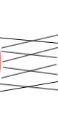
SQL JOINS
(A ∩ B) U (A-B)U(B-A)
FULL OUTER JOIN − Returns rows when there is a match in one of the tables.
SELF JOIN − Used to join a table to itself as if the table were two tables, temporarily renaming at least one table in the SQL statement.
CARTESIAN JOIN (CROSS JOIN) − Returns the Cartesian product of the sets of records from the two or more joined tables.
Table
A
Table
B
Table
A
(Join Itself)
Table
A
Table
B

Slide 41
SQL INNER JOIN
The INNER JOIN creates a new result table by combining column values of two tables (table1 and table2) based upon the join-predicate. The query compares each row of table1 with each row of table2 to find all pairs of rows which satisfy the join-predicate.
SYNTAX :
SELECT table1.col1, table2.col2,…, table1.coln
FROM table1
INNER JOIN table2
ON table1.commonfield = table2.commonfield;

Slide 42
SQL INNER JOIN
Display details of employee and department
department_id is a common column between employees & departments tables
'e' and 'd' are alias for the table names

Slide 43
SQL INNER JOIN
employee_id | first_name | last_name | salary
100 | Erik | John | 10000
department_id
12
11
10
12
department_id | department_name | manager_id | location_id
103
Harry
Potter
20000
10
IT
200
1700
102
Edwin
Thomas
15000
11
Marketing
201
1800
101
Steven
Cohen
10000
13
Resources
203
2400
14
Shipping
121
1500
SELECT e.employee_id, e.first_name, e.last_name, d.department_id,
d.department_name
FROM employees e
INNER JOIN departments d
ON e.department_id=d.department_id;
employee_id | first_name | last_name | department_id | department_name
101 | Steven | Cohen | 10 | IT
102 | Edwin | Thomas | 11 | Marketing

Slide 44
SQL LEFT JOIN
The LEFT JOIN returns all the values from the left table, plus matched values from the right table or NULL in case of no matching join predicate.
SYNTAX :
SELECT table1.col1, table2.col2,…, table1.coln
FROM table1
LEFT JOIN table2
ON table1.commonfield = table2.commonfield;

Slide 45
SQL LEFT JOIN
List all employees those with and without departments
Department names will be NULL for those employees in which there are no departments

Slide 46
SQL LEFT JOIN
employee_id | first_name | last_name | salary
100 | Erik | John | 10000
Department_id
12
11
10
12
department_id | department_name | manager_id | location_id
103
Harry
Potter
20000
10
IT
200
1700
102
Edwin
Thomas
15000
11
Marketing
201
1800
101
Steven
Cohen
10000
13
Resources
203
2400
14
Shipping
121
1500
SELECT e.employee_id, e.first_name, e.last_name, d.department_id, d.department_name
FROM employees e
LEFT OUTER JOIN departments d
ON e.department_id = d.department_id;
employee_id | first_name | last_name | department_id | department_name
101 | Steven | Cohen | 10 | IT
102 | Edwin | Thomas | 11 | Marketing
103 |  |  | Null | Null
100 | Erik | John | Null | Null
Harry
Potter

Slide 47
SQL RIGHT JOIN
The RIGHT JOIN returns all the values from the right table, plus matched values from the left table or NULL in case of no matching join predicate.
SYNTAX :
SELECT table1.col1, table2.col2,…, table1.coln
FROM table1
RIGHT JOIN table2
ON table1.commonfield = table2.commonfield;

Slide 48
SQL RIGHT JOIN
List all departments those with and without managers
For those departments where there are no managers, their names will be shown as NULL

Slide 49
SQL RIGHT JOIN
employee_id | first_name | last_name | salary
100 | Erik | John | 10000
department_id
12
11
10
12
department_id | department_name | manager_id | location_id
103
Harry
Potter
20000
10
IT
200
1700
102
Edwin
Thomas
15000
11
Marketing
201
1800
101
Steven
Cohen
10000
13
Resources
203
2400
14
Shipping
121
1500
SELECT e.employee_id, e.first_name, e.last_name, d.department_id, d.department_name
FROM employees e
RIGHT JOIN departments d
ON e.department_id=d.department_id;
employee_id | first_name | last_name | department_id | department_name
101 | Steven | Cohen | 10 | IT
102 | Edwin | Thomas | 11 | Marketing
Null | Null | Null | 13 | Resources
Null | Null | Null | 14 | Shipping

Slide 50
SQL FULL OUTER JOIN
The FULL OUTER JOIN combines the results of both left and right outer joins. The joined table will contain all records from both the tables and fill in NULLs for missing matches on either side.
SYNTAX :
SELECT table1.col1, table2.col2,…, table1.coln
FROM table1
Left JOIN table2
ON table1.commonfield = table2.commonfield;
Union
SELECT table1.col1, table2.col2,…, table1.coln
FROM table1
Right JOIN table2
ON table1.commonfield = table2.commonfield;

Slide 51
SQL FULL OUTER JOIN
employee_id | first_name | last_name | salary
100 | Erik | John | 10000
department_id
12
11
10
12
department_id | department_name | manager_id | location_id
103
Harry
Potter
20000
10
IT
200
1700
102
Edwin
Thomas
15000
11
Marketing
201
1800
101
Steven
Cohen
10000
13
Resources
203
2400
SELECT e.employee_id, e.first_name, e.last_name, d.department_id, d.department_name
FROM employees e
LEFT JOIN departments d
ON e.department_id=d.department_id
UNION
SELECT e.employee_id, e.first_name, e.last_name, d.department_id, d.department_name
FROM employees e
RIGHT JOIN departments d
ON e.department_id=d.department_id;
14
Shipping
121
1500
employee_id | first_name | last_name | department_id | department_name
101 | Steven | Cohen | 10 | IT
102 | Edwin | Thomas | 11 | Marketing
103 |  |  | Null | Null
100 | Erik | John | Null | Null
Null | Null | Null | 13 | Resources
Null | Null | Null | 14 | Shipping
Harry
Potter

Slide 52
SQL SELF JOIN
The SELF JOIN joins a table to itself; temporarily renaming at least one table in the SQL statement.
SYNTAX:
SELECT a.col1, b.col2,..., a.coln
FROM table1 a, table1 b
WHERE a.commonfield = b.commonfield;

Slide 53
SQL SELF JOIN
employee_id | first_name | manager_id
1 | Steven
2 | Neena | 1
3 | Lex | 2
4 | Alex | 3
5 | Bruce | 3
SELECT emp.employee_id, emp.first_name, emp.manager_id, mgr.first_name FROM employeess emp inner join employeess mgr on emp.manager_id = mgr.employee_id;
employee_id | first_name | manager_id | first_name
2 | Neena | 1 | Steven
3 | Lex | 2 | Neena
4 | Alex | 3 | Lex
5 | Bruce | 3 | Lex

Slide 54
SQL CROSS JOIN
The CROSS JOIN produces a result set with the number of rows in the first table multiplied by the number of rows in the second.
SYNTAX:
SELECT table1.col1, table2.col2,…, table1.coln
FROM table1
CROSS JOIN table2;

Slide 55
SQL CROSS JOIN
Assume there are 4 records in table1 and 3 records in table2
SELECT * FROM table1
CROSS JOIN table2;
A | 1
A | 2
A | 3
B | 1
B | 2
B | 3
C | 1
C | 2
C | 3
D | 1
D | 2
D | 3
Table-1
Table-2
alpha
A
B
C
D
Num
1
2
3

Slide 56
THANK YOU

